Slide 1
Verdediging WebDev II
Owen De Waele 2018-19

Slide 2
Briefing
Extra print

Slide 3
Planning
Extra Print

Slide 4
Analyse
Extra Print

Slide 5

Moodbord

Slide 6
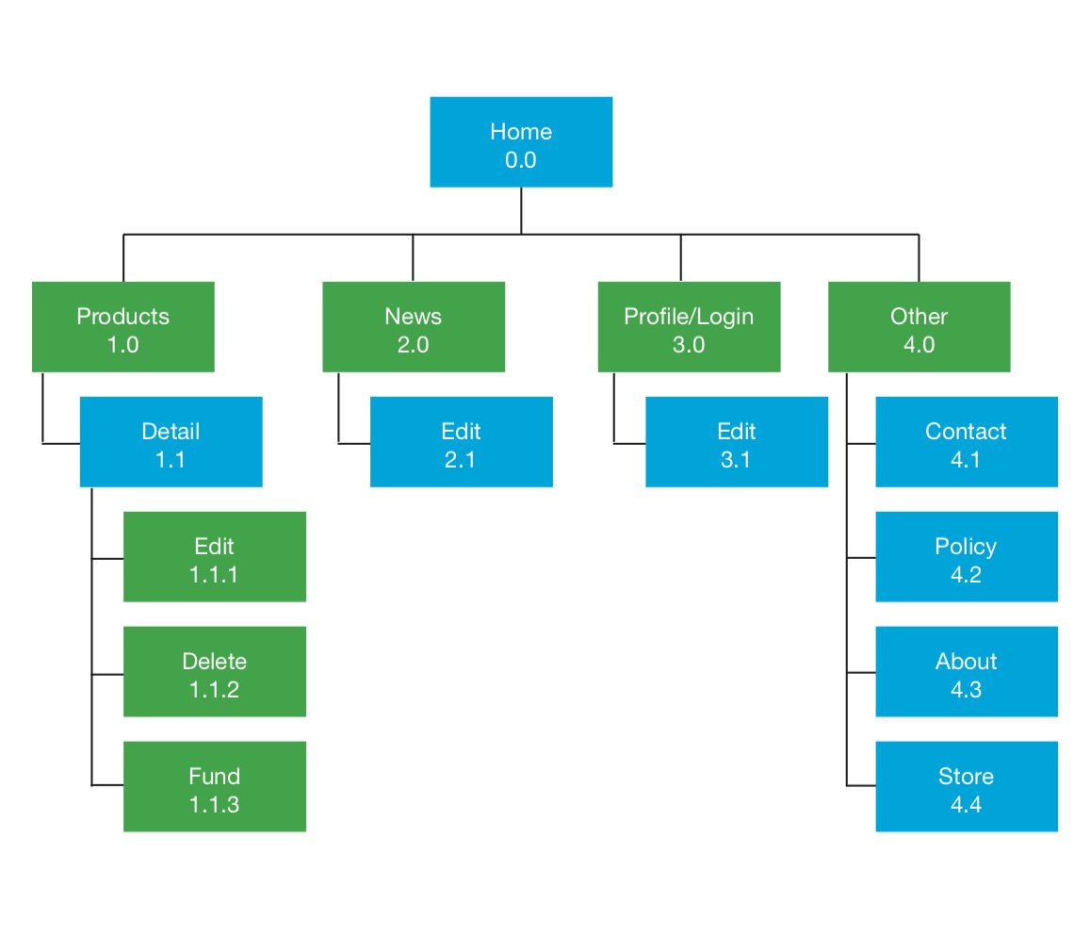
Sitemap

Slide 7
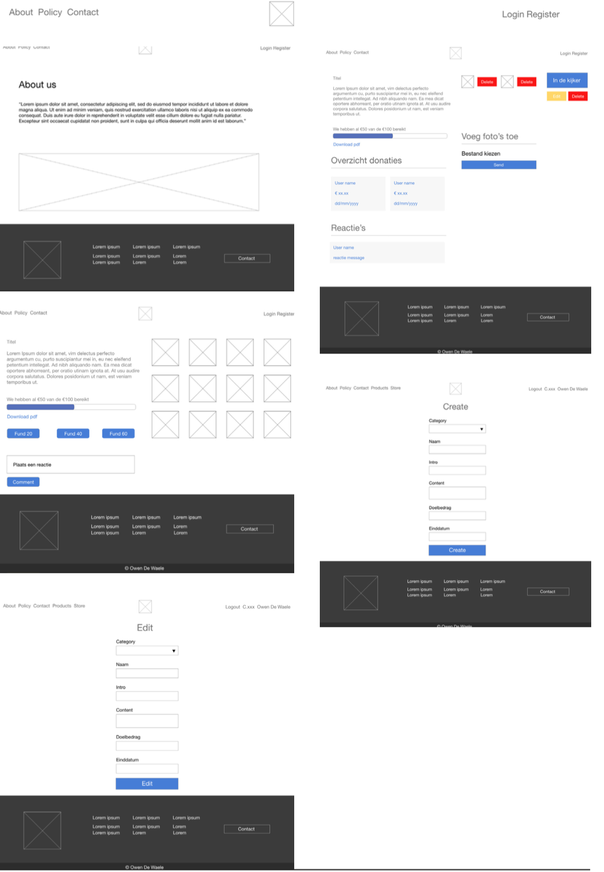
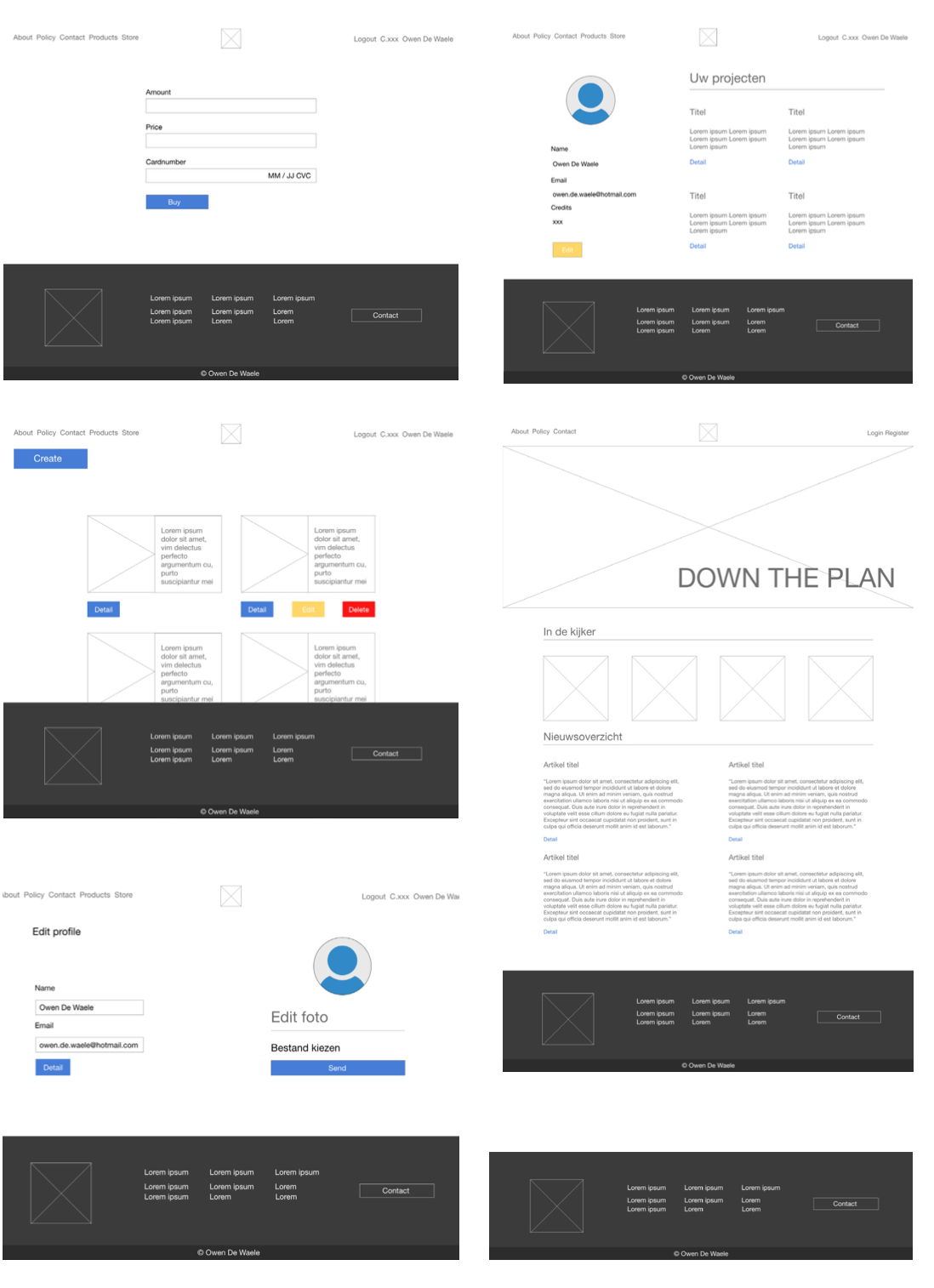
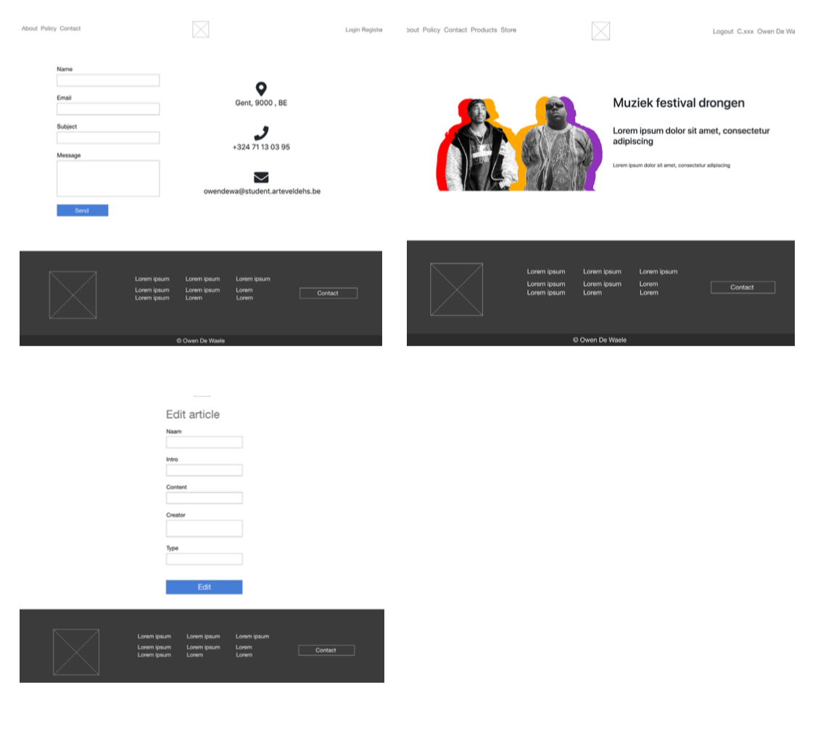
Wireframes

Slide 8
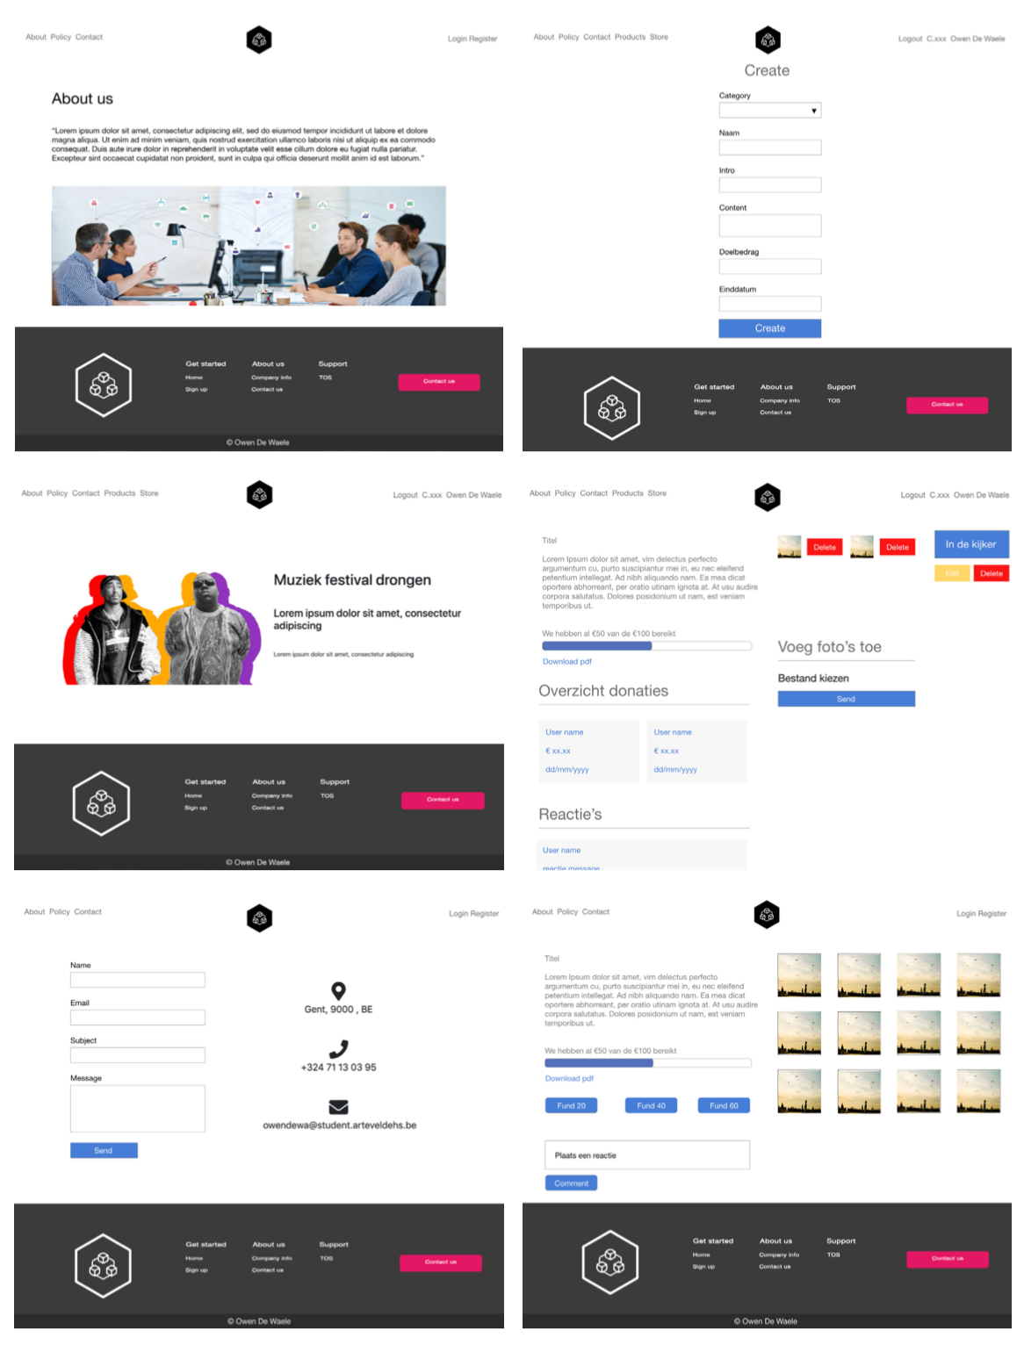
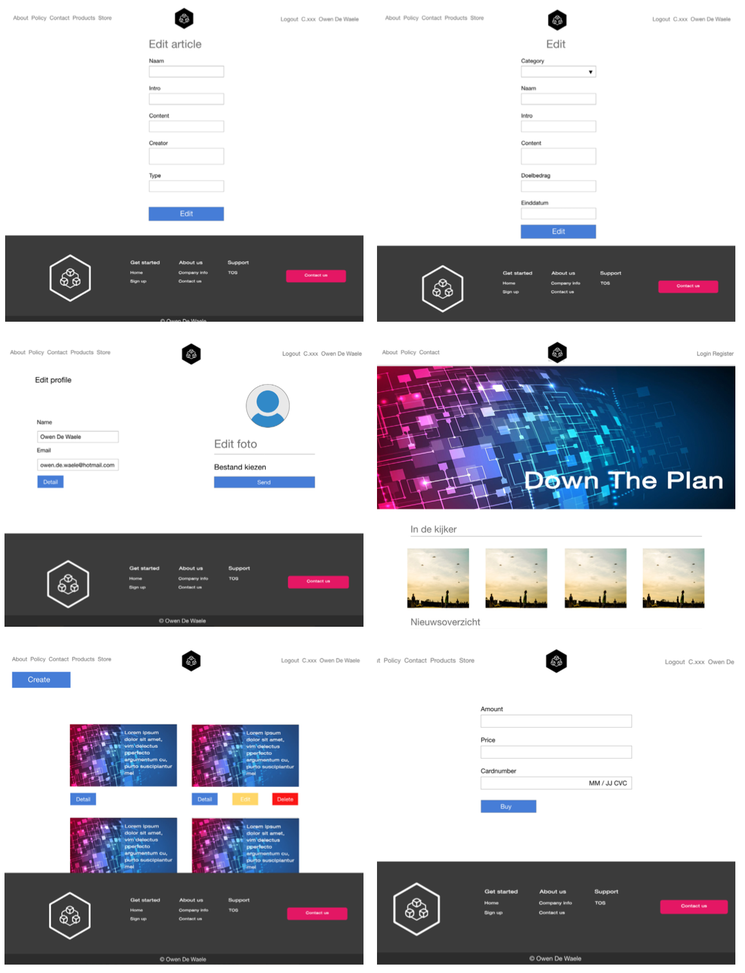
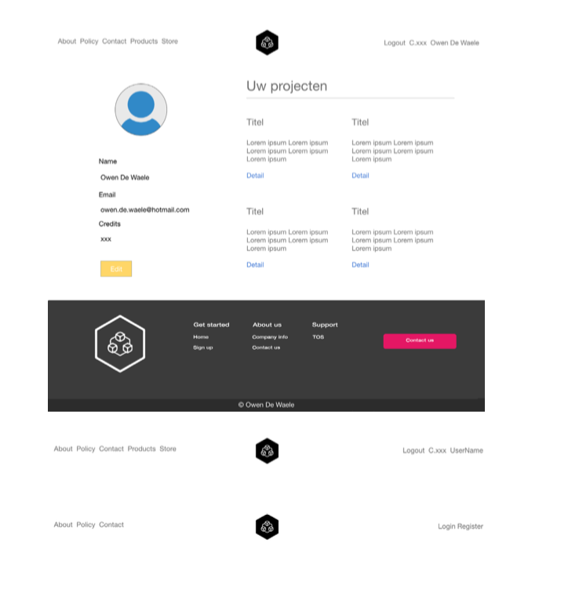
Designs

Slide 9
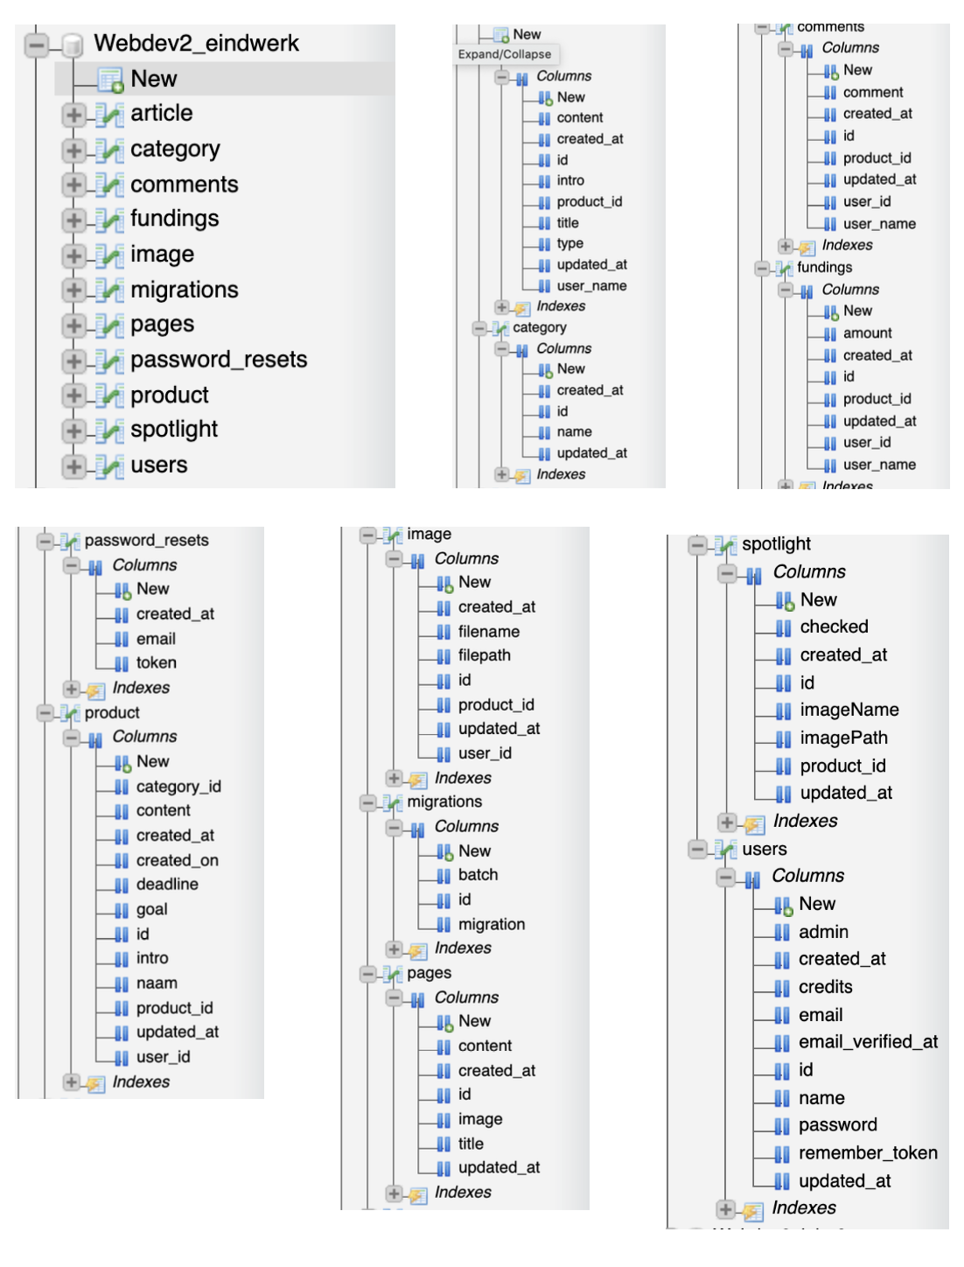
Database

Slide 10
User Guide
Extra print

Slide 11
Deployment Guide
Extra print

Slide 12
Demo

